Slide 1
Building Basic CalculatorUsing Python Tkinter
Submitted by: <apna naam>Organization: NextHikes IT SolutionsTechnology: Python, TkinterIDE: Visual Studio Code

Slide 2
Introduction
• Calculator is a basic application• This project is developed using Python• Tkinter is used to create GUI• It performs basic arithmetic operations

Slide 3
Project Objective
• To learn Python GUI development• To understand Tkinter library• To build a user-friendly calculator• To perform basic arithmetic operations

Slide 4
Tools and Technologies Used
• Python Programming Language• Tkinter Library• Visual Studio Code (IDE)• GitHub

Slide 5
Features of Calculator
• Graphical User Interface (GUI)• Display screen for input and output• Number buttons (0–9)• Arithmetic operations (+, −, ×, ÷)• Clear (C) button• Equal (=) button

Slide 6
Working of Calculator
• User clicks number and operator buttons• Expression is shown on display screen• Equal button performs calculation• Result is displayed on screen

Slide 7
Code Overview
• Tkinter is used for GUI creation• Entry widget is used for display• Button widget is used for input• eval() function is used for calculation

Slide 8
Output
• Calculator window opens• User can perform calculations• Correct result is displayed

Slide 9
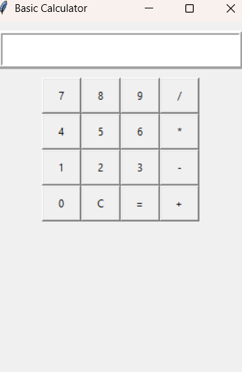

Slide 10
Learning Outcome
• Core Python concepts• Tkinter GUI development• Application development skills• Use of IDE and GitHub

Slide 11
Conclusion
• Project successfully completed• Basic calculator implemented using Python• Tkinter library was learned• Project improved GUI programming skills

